Slide 1
Front End Engineering-I Project
Team Details:
Jaikirat Dev 2210990428
Jaivardhan Khanna 2210990429
Janvi Jain 2210990430
Janvi Sethi 2210990431
Faculty Coordinator: Dr. Chetna Kaushal
:
Chitkara University Institute of Engineering and Technology,
Chitkara University, Punjab

Slide 2
Table of Contents
Introduction
Definition
Problem Statement
Technical Details
Key Features
Advantages
Project Highlights
Conclusion
References/Links used

Slide 3
Introduction
Test Management System
Effective Test Management System is necessary because it helps in checking if a person understands the subject by asking questions based upon the Subject. It helps in
grasping the concept of the subject by asking different questions form the applicant whenever he opts to take the test.

Slide 4
Problem Statement
A test management portal is to be designed using HTML, CSS and JavaScript. It is like a portal consisting of MCQs that can be based upon the subject the applicant chooses and based upon the right/wrong answers ,a score sheet with detail marks and information about the applicant can be maintained.

Slide 5
Technical Details
Building this system is technically feasible. The hardware and software needed are all available, it not difficult to get them. Brief I can say the necessary resources needed for the development and maintenance of the system are available. We are going to use HTML, CSS and java programming language to complete this project.

Slide 6
Key Features
Front page of the examination website is shown.
A login page is formed for students to enter their required details for taking the exam.
Student can select the subject for which he wants to give exam from the given subjects.
MCQ based test will be generated.
Student can select options for the correct answer.
Timer will be shown on the top of the test page.
Result page will be generated in the end.

Slide 7
ADVANTAGES
The advantages of a test management system are :
It helps a candidate in grasping the subject .
It can increase the versatility of the candidate’s knowledge by allowing him/her to opt and give test for different subjects.
It can help a candidate improve from his/her mistakes.

Slide 8
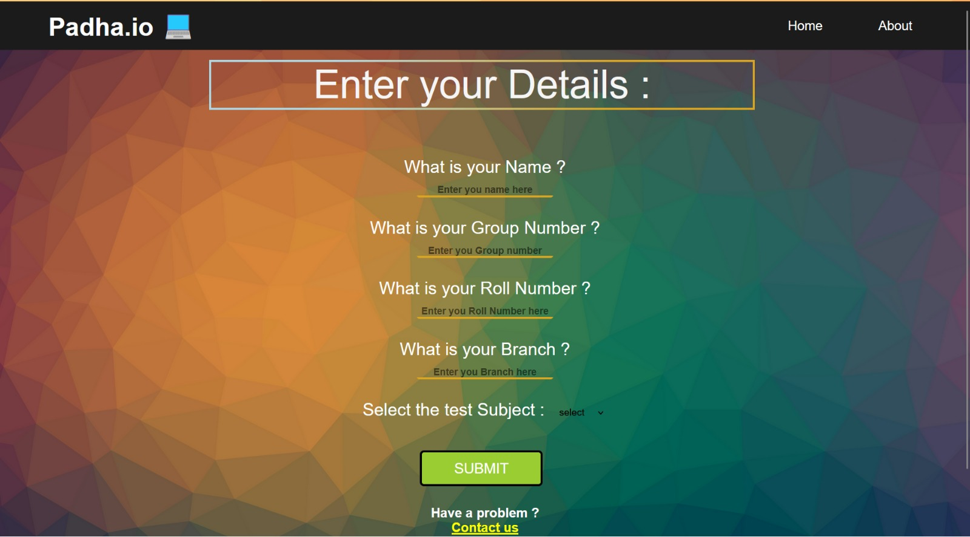
Project Highlights
Front Page

Slide 9
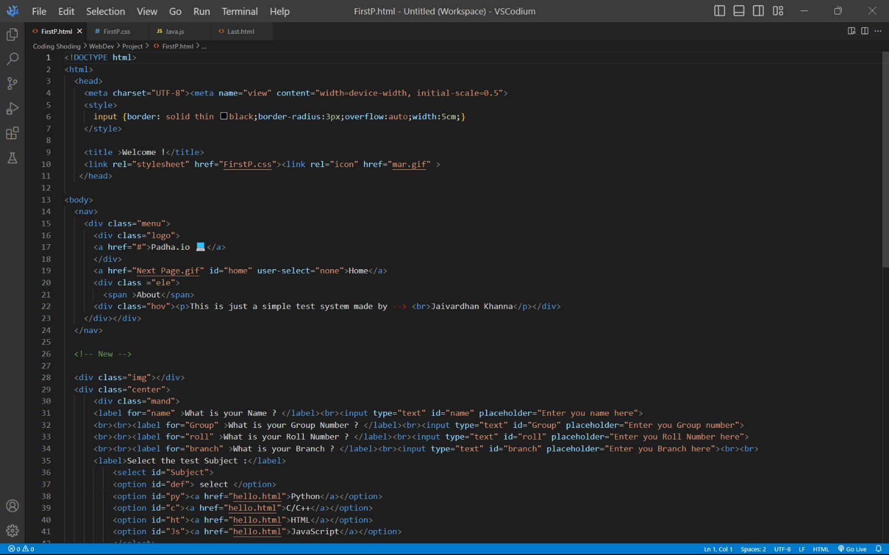
Project Highlights
Code Snippets:

Slide 10
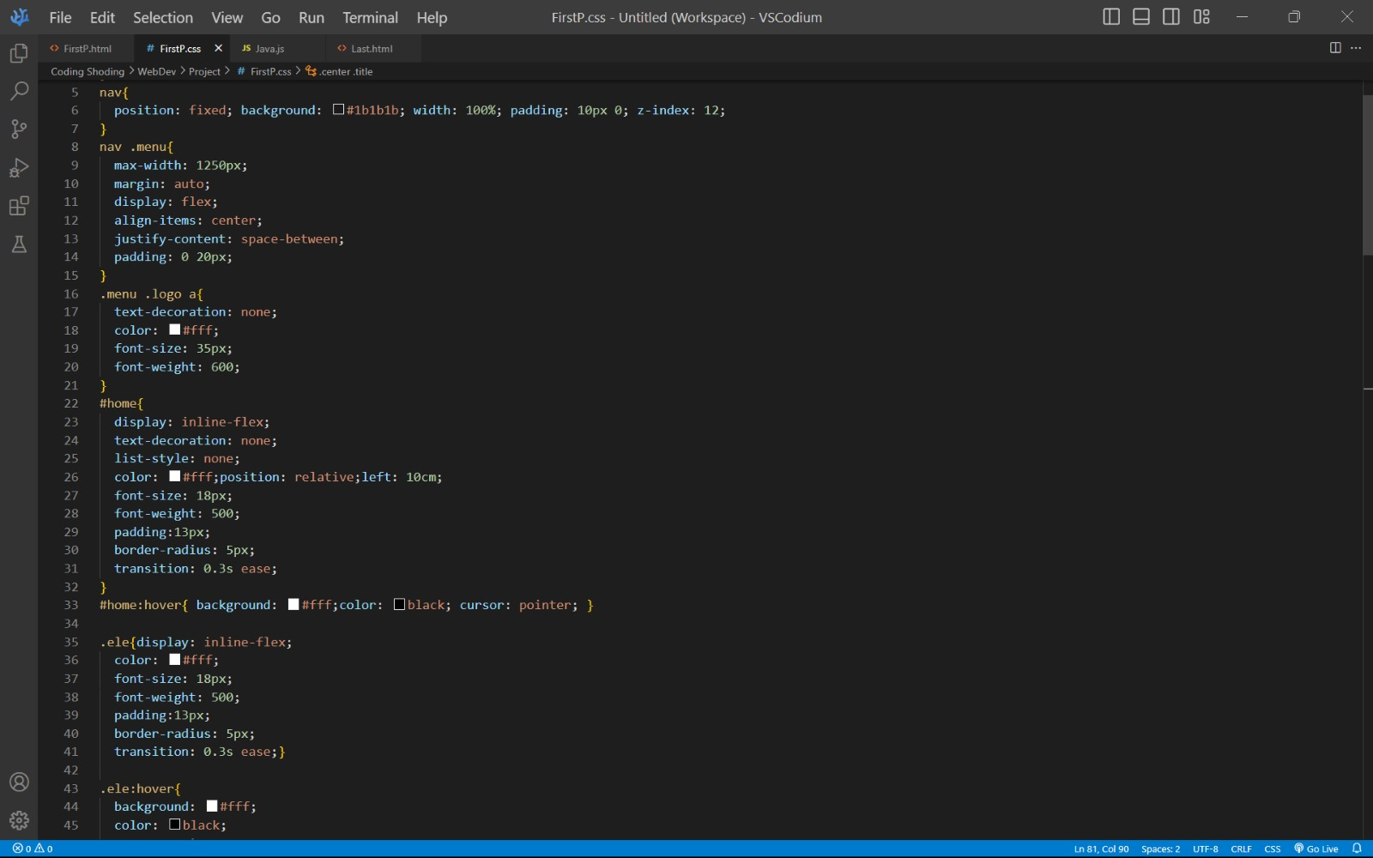
CSS layout of Front Page

Slide 11
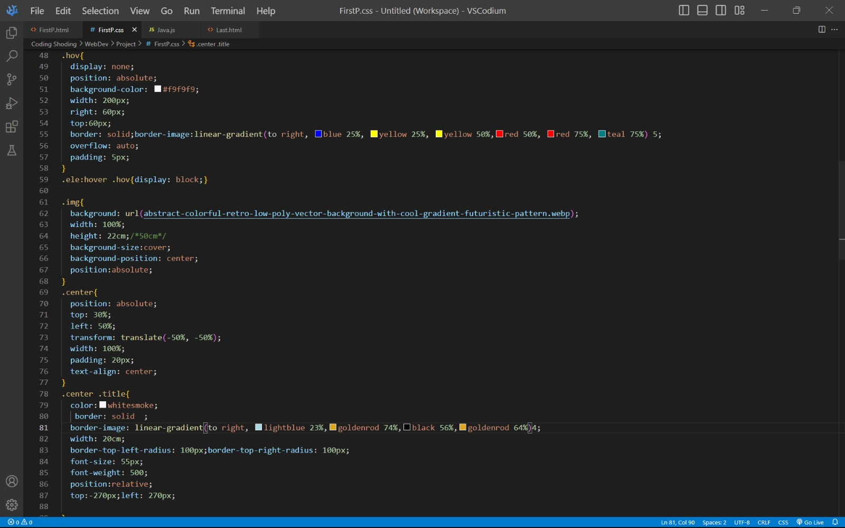
CSS Layout of Front Page

Slide 12
Conclusion
With the completion of this project we conclude that it has achieved its purpose.
The whole project provides a base for students to take their exam using software.
The system is developed using HTM, CSS and Java programming language.
Online examination is the best compared to paper-based exam.
The automated system helps students and lecturers to save time and makes the process faster.
It saves space since answers papers will not be used.
With a user friendly system that has security, integrity and the database is neither inconsistent nor redundant.

Slide 13
References/Links used
Website to learn HTML CSS JAVA :
https://Mozilla.org.com
https://www.w3schools.com
https://practice.geeksforgeeks.org
https://codescholl.com
Books:
‘Web Enabled Commercial Application Development using HTML, JavaScript, DHTML and PHP’ by Ivan Bayross, 4th Edition, BPB Publications.
‘The Complete Reference HTML & XHTML’ by Thomas Powell, 5th Edition, Tata McGraw-Hill Company Limited.

Slide 14
Thank you
for your time 😊

